Slide 1
OBJECT DETECTION

Slide 2
PROJECT GOAL
GOAL
Identifying ships from the satellite images with high precision.
USE CASES
This solution will help in improving our response to environmental disasters, piracy, illegal cargo movement, etc...

Slide 3
ETL STRATEGY
Kaggle - Extracted CSV and Raw images
Created a train and validation data set for 4k, 8k and 16k images
Converted images to recordio and lst format
From s3 to sagemaker to train the model
Load the image file to S3

Slide 4
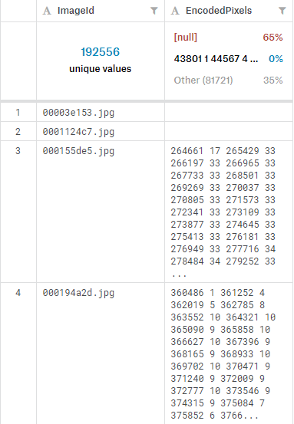
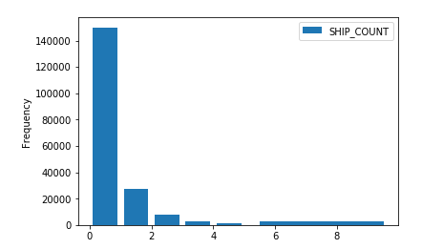
DESCRIPTIVE ANALYTICS
Raw Data from Train Data Set
Total number of rows in raw file - 231,723
Number of rows with image - 192,556
Number of images contain one or more ships - 42,556 (22%)
Number of images with no ship - 150,000 (78%)

Slide 5
MODELING STRATEGY
Image classification problem
We used Sagemaker's image classification built-in algorithm to solve this problem.
Transfer learning using pre-trained ResNet-18 architecture
Two-class softmax classification: SHIP or NO SHIP
Hyperparameters:
Training set size: 4K, 8K, 16K
Number of layers: 18
Mini-batch size: 10
Learning rate: 1e-2
Interpreted accuracy with epochs and confusion matrix

Slide 6
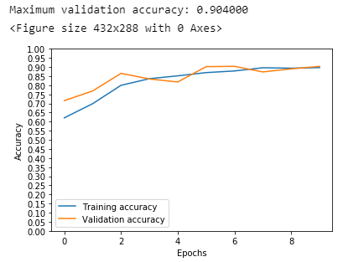
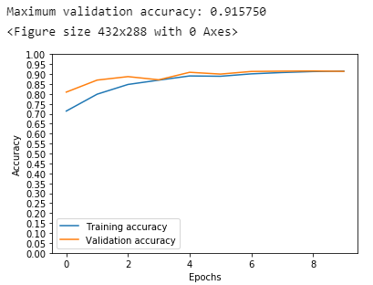
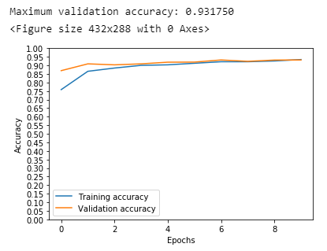
EPOCHS and ACCURACY
Data Set : 4000 Images
Data Set : 8000 Images
Data Set : 16000 Images

Slide 7
CONFUSION MATRIX
True Positive False Positive
898 57
False Negative True Negative
102 943
False Negative : Ship was not identified.
For example, Drug trafficking and piracy would potentially result in loss of life.
False Positive : Ship identified falsely. Increase in cost and lost in time.
For example, false leads will be provided to search and rescue teams resulting in lost time and efforts.
Recall: 94.3%
Precision: 90.2%

Slide 8
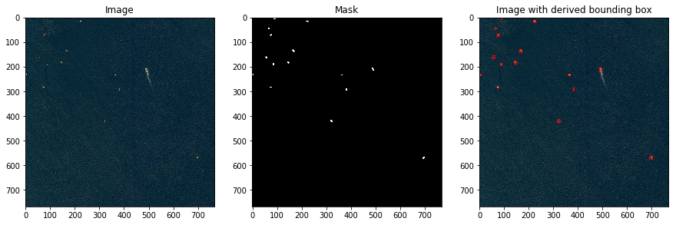
ERROR MODES : Missed Ships (FNs)

Slide 9
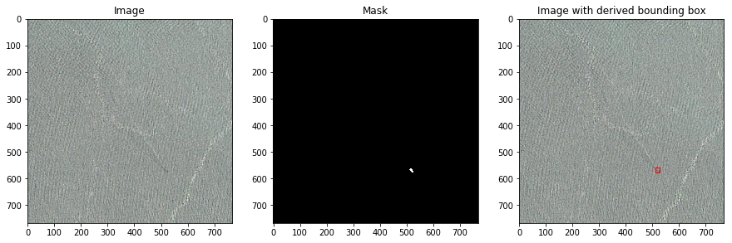
ERROR MODES : Missed Ships (FNs)

Slide 10
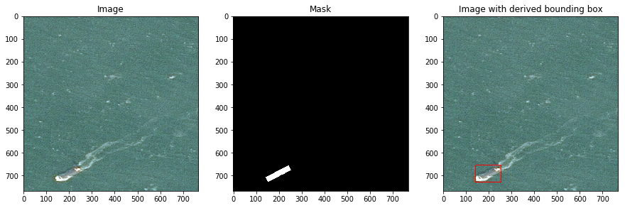
ERROR MODES : Missed Ships (FNs)

Slide 11
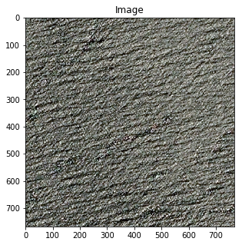
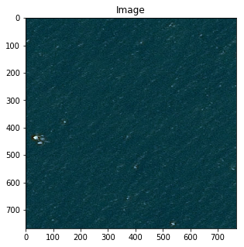
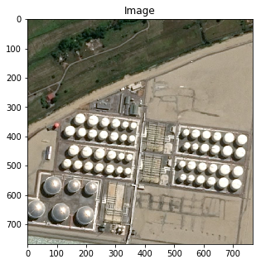
ERROR MODES : Imagined Ships (FPs)

Slide 12
NEXT STEPS
Assuming continued free access to amazing AWS/SageMaker:
Scale the training set (and validation)
Increase capacity of the network (e.g., larger/more FC layers)
Tune additional hyperparameters (learning rate, batch size, epochs, etc.)
Extend error analysis to identify edge cases
Move to object localization (bounding boxes or pixel-level segmentation)

